Slide 1


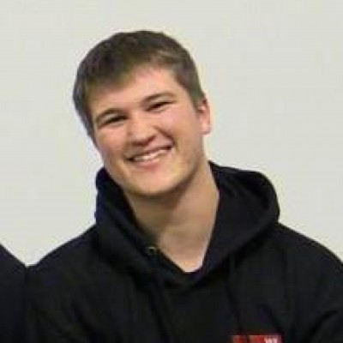
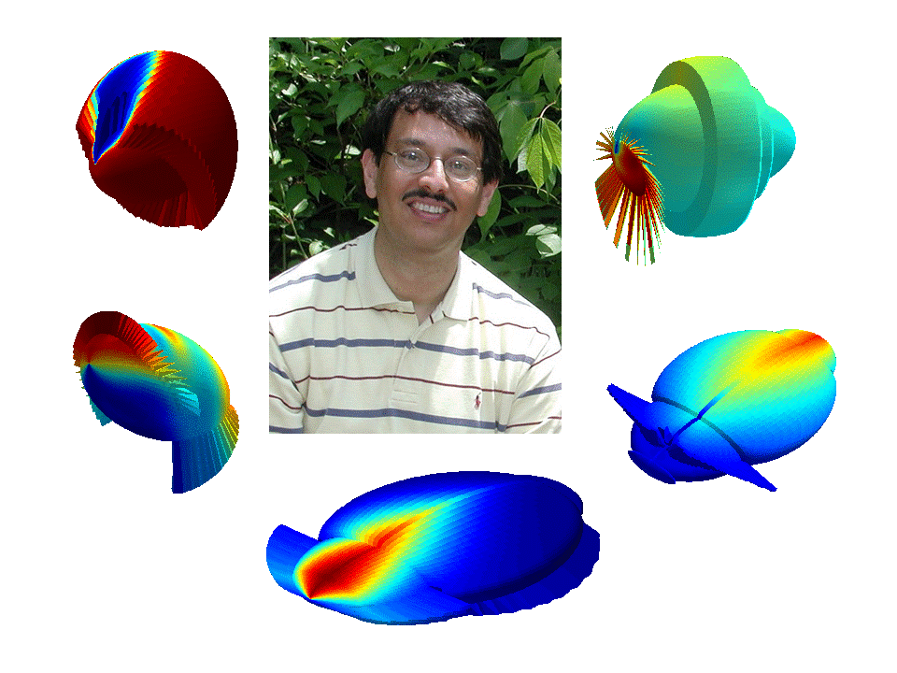



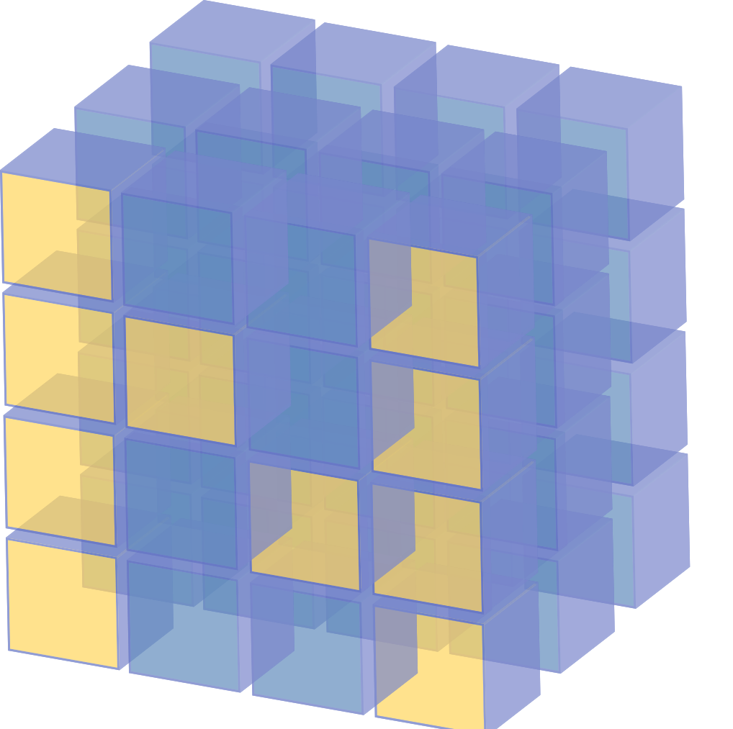
Background
There have been many recent advances in game-playing AIs, such as the Dota 2 AI and AlphaGo. With this project, we aim to explore the use of conventional and cutting edge machine learning techniques to create a self-learning Starcraft 2AI agent that is capable of playing against Blizzard’s built-in AI.
Kyle Arens
Ryan Benner
Design/Input
Diagram
Jon’s Aforementioned Playground
Jon Deibel
Dr. Ali Minai
Advisor
Milestone Achievements
10/31 – Develop a scripted AI using capable of defeating Medium AI opponents.
12/05 – Implemented a simple Q-learned model capable of occasionally winning against Very Easy AI.
1/13 – Update to a deep-learned model with better success than Q-learned.
2/5 – Update reward algorithm to use player score. No noticeable change.
Scope & Decisions
With 3 distinct factions to play as and an action space of ~10⁸ possibilities, we limited our project in the following ways:
Only train as Terran.
Only train on a small 64x64 map.
Train via reinforcement only against Blizzard AI.
Reduce action space of our AI to about 6 actions.
Prevent training bot to move camera.
Feed the AI the current screen region and 7 distinct minimap layers.
Future Work
Expand action space to the full possibility of Terran’s actions.
Train against multiple maps.
Train AI to change camera location.
Utilize Pro-player replay data.
Expand input space to include all mini-map layers.
Train AI to play as Protoss and Zerg.
Scope limitation / design decisions
Challenges/roadblocks?

